Slide 1
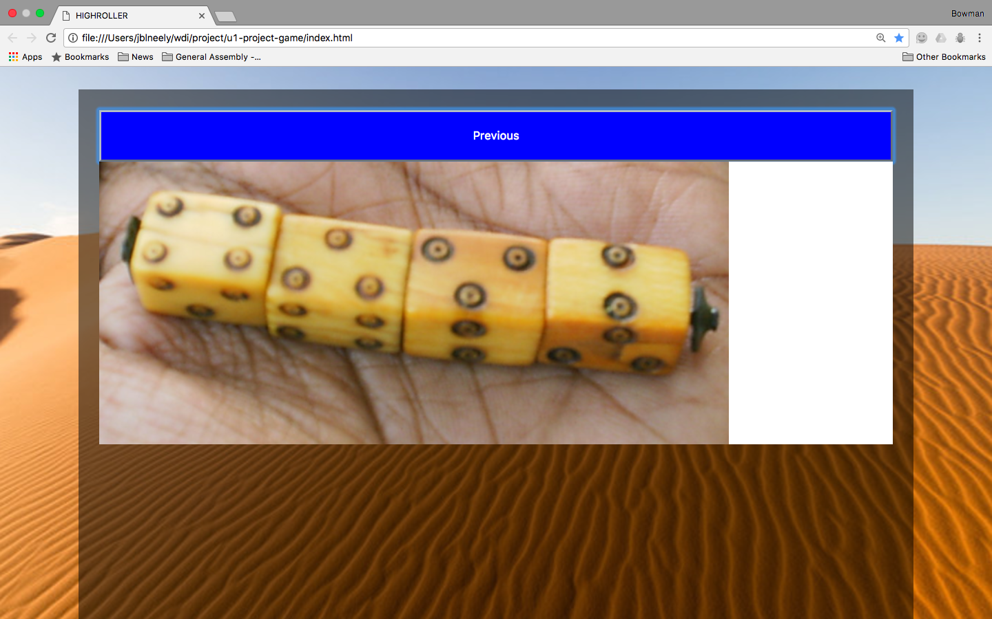
Dice
Notes:
The oldest surviving dice were found in Persia. Dice were used to interpret theological texts – the roll indicating a relevant selection of text. I thought it would be cool to use math.random to perform these functions going back to 6bc.

Slide 2
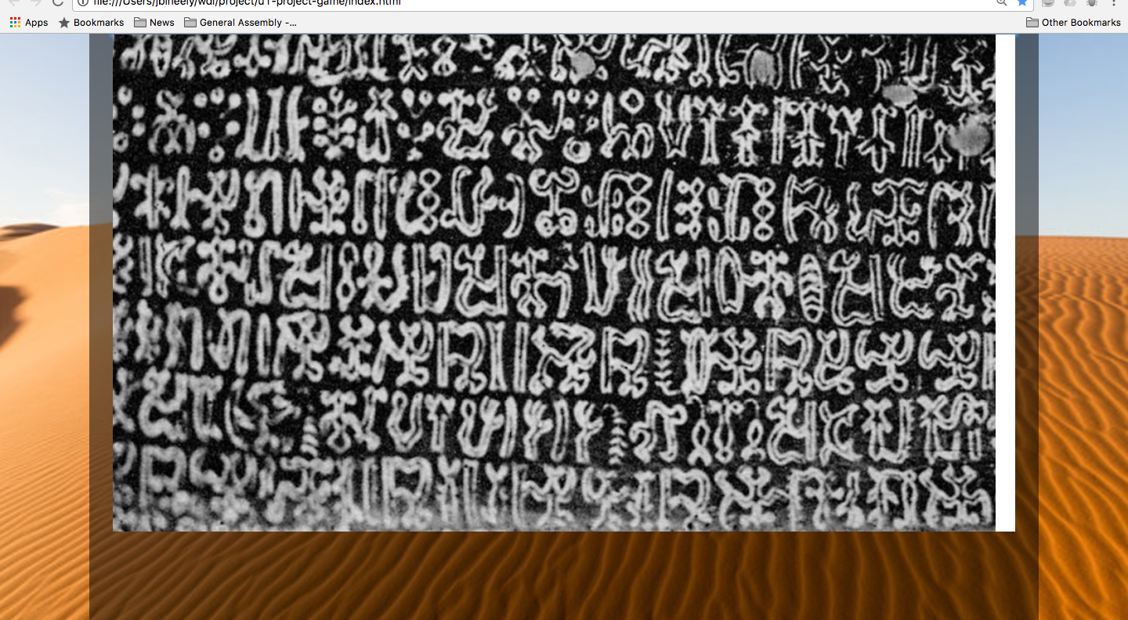
text
Notes:
This is an example of the divine text that could be interpreted

Slide 3
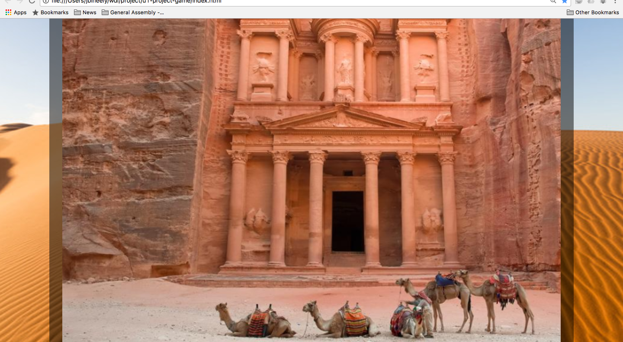
Notes:
Petra, when all your belongings are on a camel – you need to travel light.

Slide 4
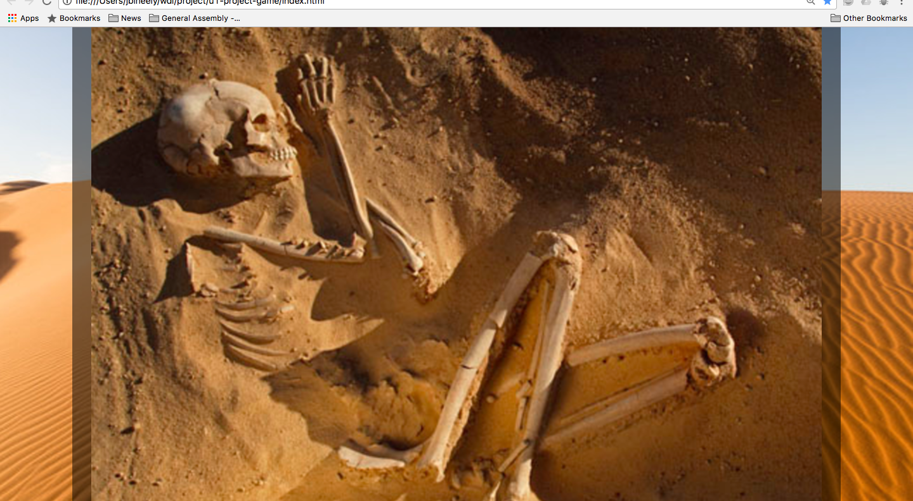
Notes:
Games of chance have an allure – they provide determination in a chaotic system, albeit seemingly by chance. This slide is just a momento mori – I mean, why not take a chance…we don’t live forever. Also, according to the internet this woman lived 6,000 years ago when the earliest examples of dice were used.

Slide 5
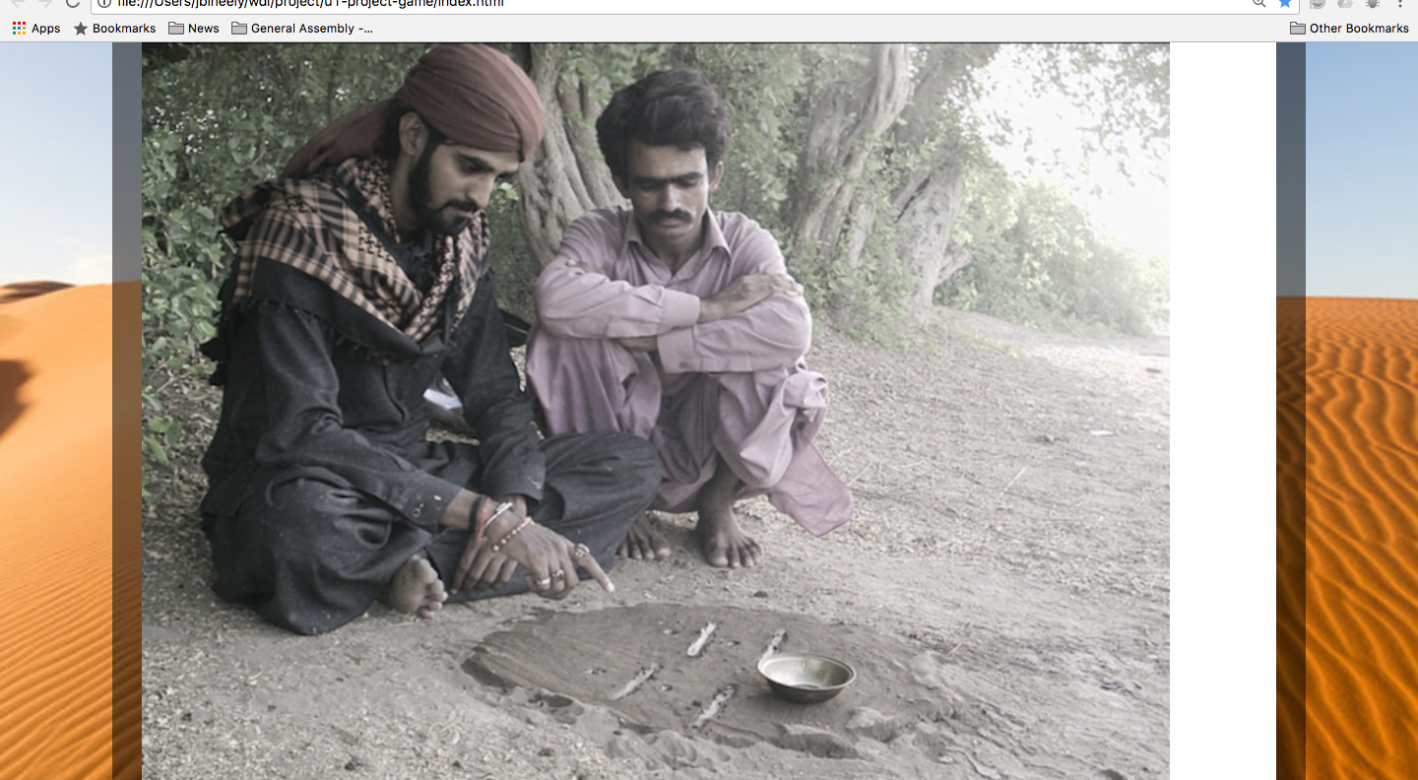
Notes:
These geomancers, use dice to make marks in the earth which they then interpret. My idea was to give them a list of 20 answers (a nebulous message of 10 positive, 5 nebulous, and 5 negative responses) – to correspond with the dice. Also, I the die would have faces with symbols rather than numbers. Highroller was more effective as a means of determinism – high low – rather than :

Slide 6
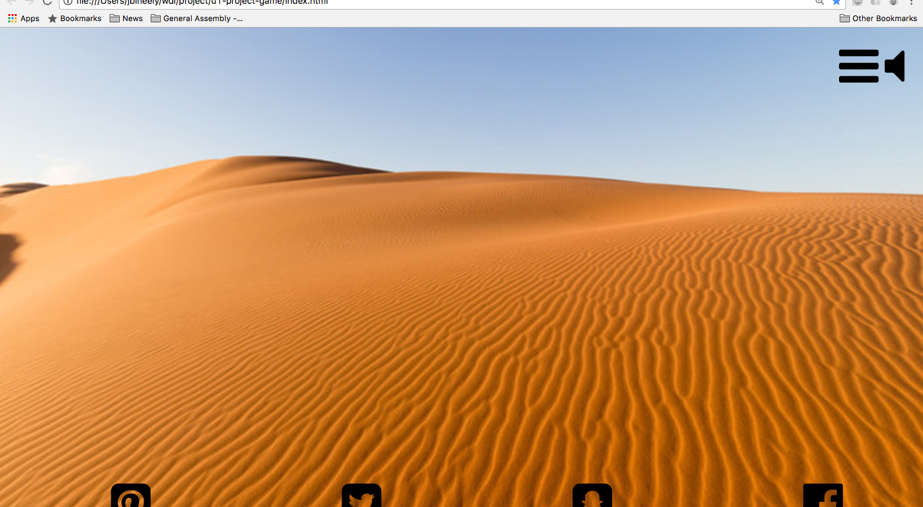
Opening page
Notes:
I wanted a clean opening page, with just icons to open the menu, select sound, or connect with social media.

Slide 7
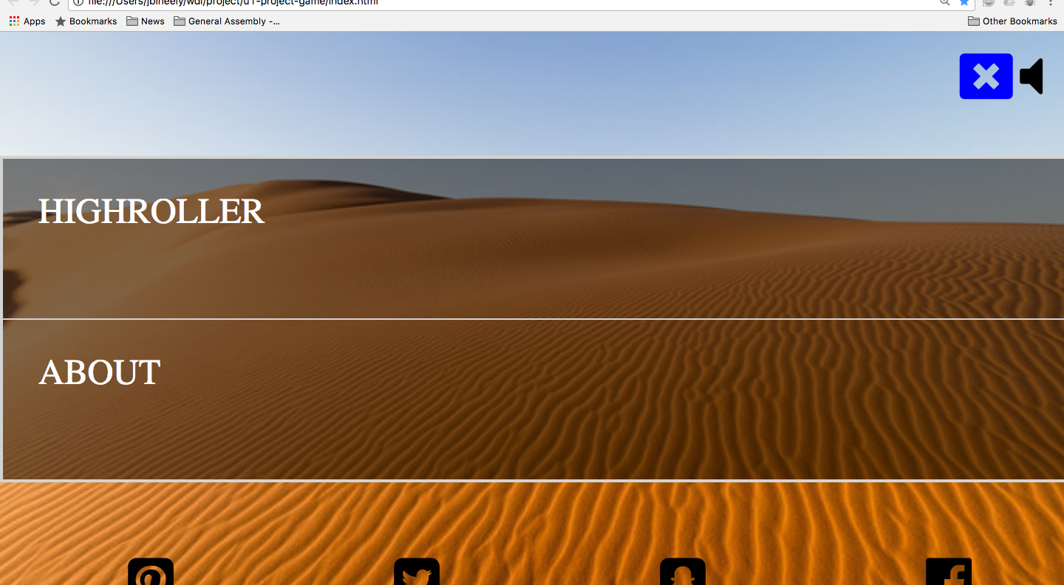
Menu List
Notes:
When you hover on the icons, they transition color. When you click on the menu, a close menu icon replaces it.

Slide 8
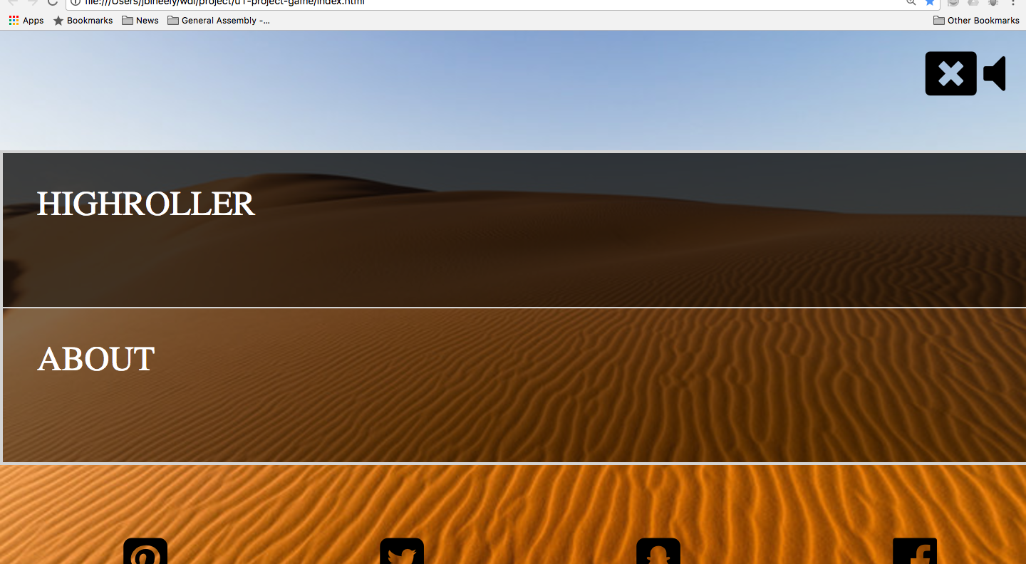
Menu
Notes:
When you hover over the menu items, the background darkens to let you know which is selected.

Slide 9
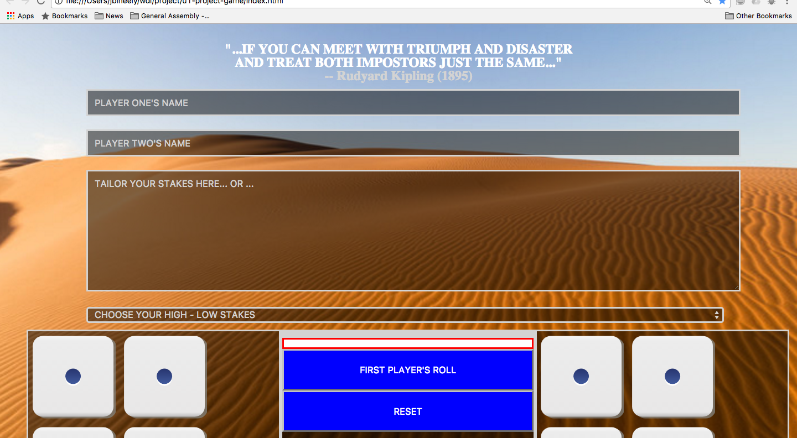
Form
Notes:
Users input their names and either draft their own terms, or select from a drop down menu.

Slide 10
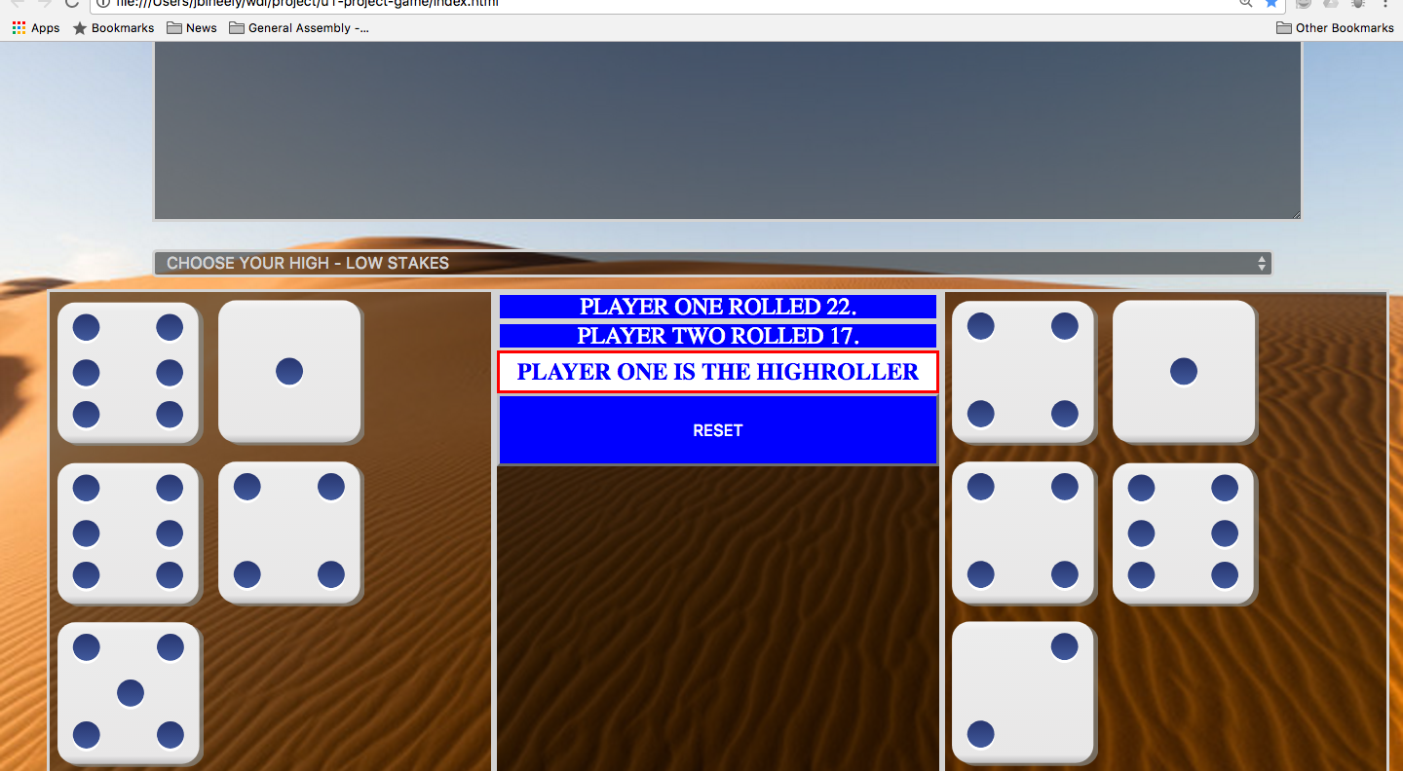
The dice and output

Slide 11
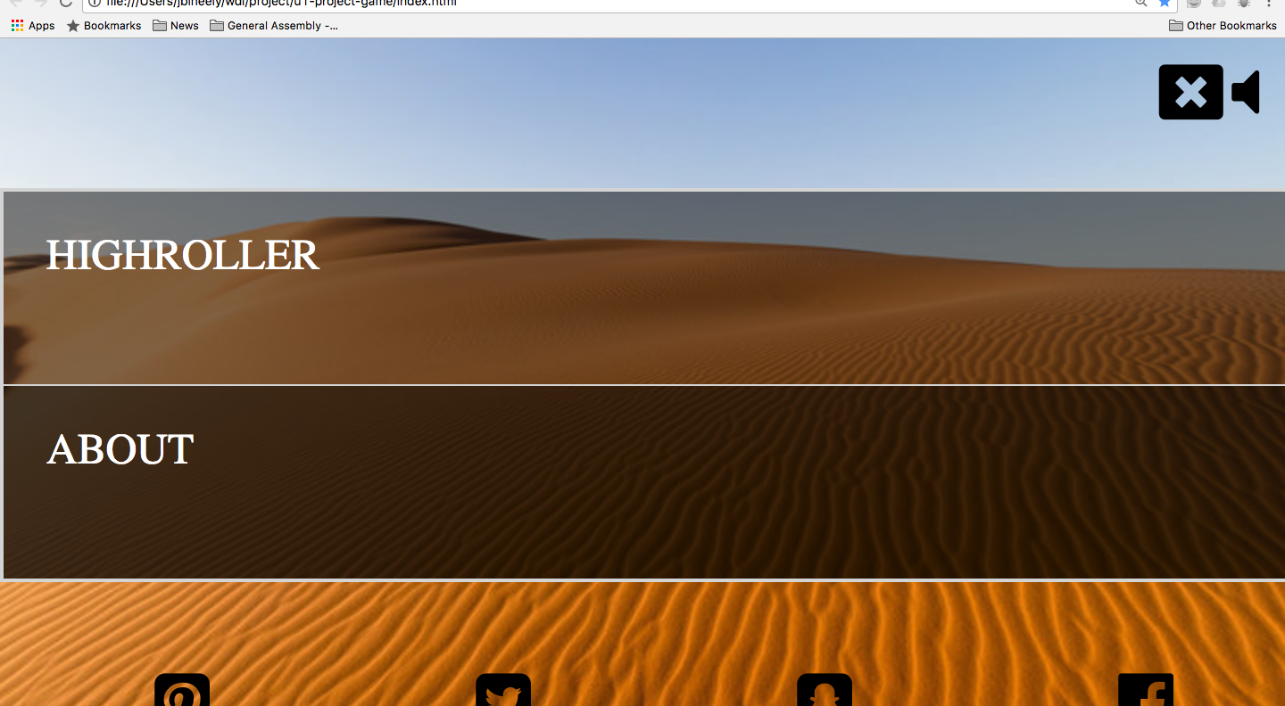
Visual About

Slide 12
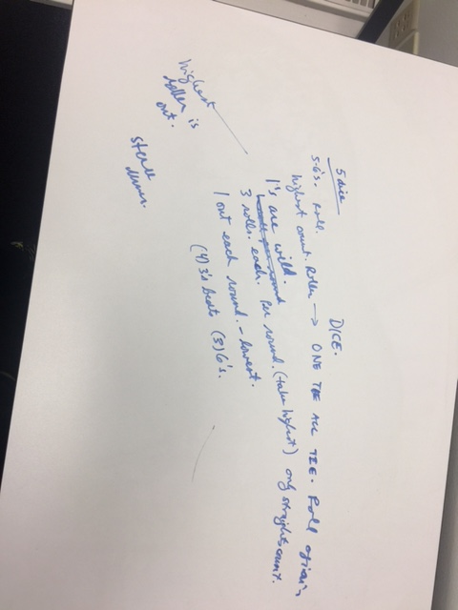
whiteboarding

Slide 13
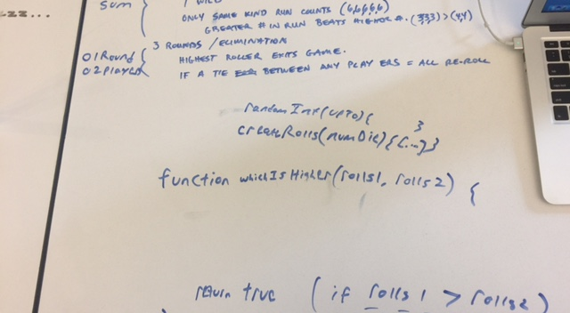
Whiteboarding

Slide 14
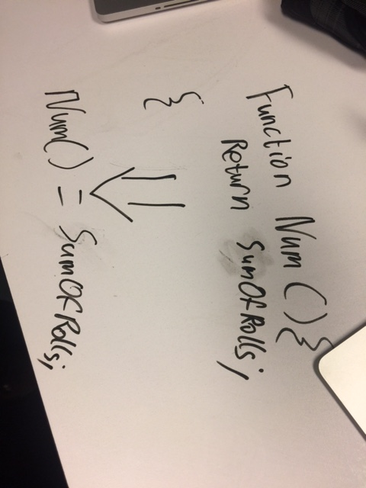
Whiteboarding

